Slide 1
Difference between Checked Exception and Unchecked Exceptions
momedaram

Slide 2
Checked Exception:
The exceptions which are checked by compiler for smooth execution of the program at runtime are called Checked exceptions.
These exceptions must be handled properly either using try-catch blocks or using throws clause, otherwise compiler will throw error.
Unchecked Exceptions:
The Exceptions which are not checked by compiler are called unchecked exceptions.
If these exceptions are not handled properly, compiler will not throw any error. But you may get error at run time.

Slide 3
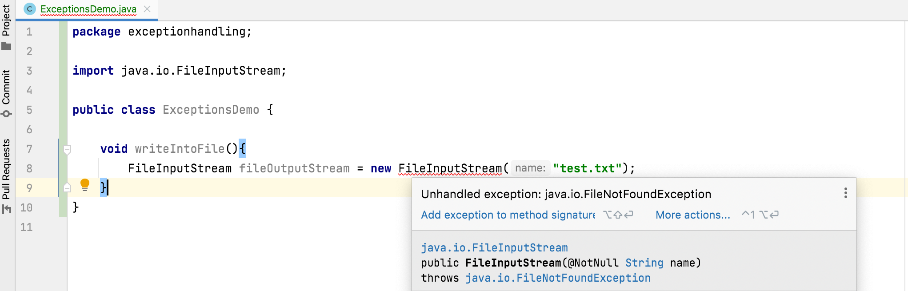
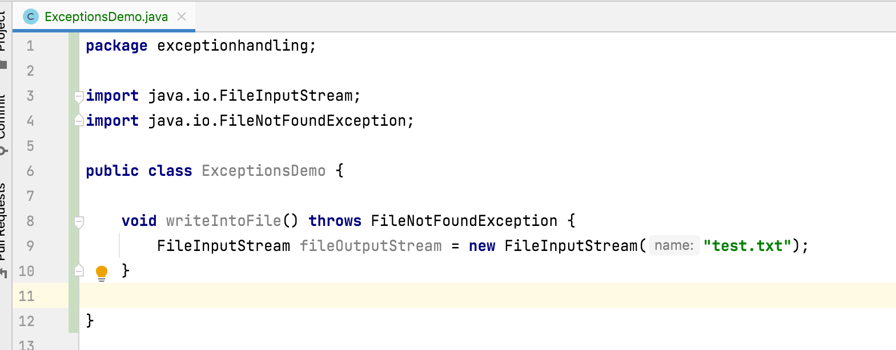
Checked Exceptions

Slide 4
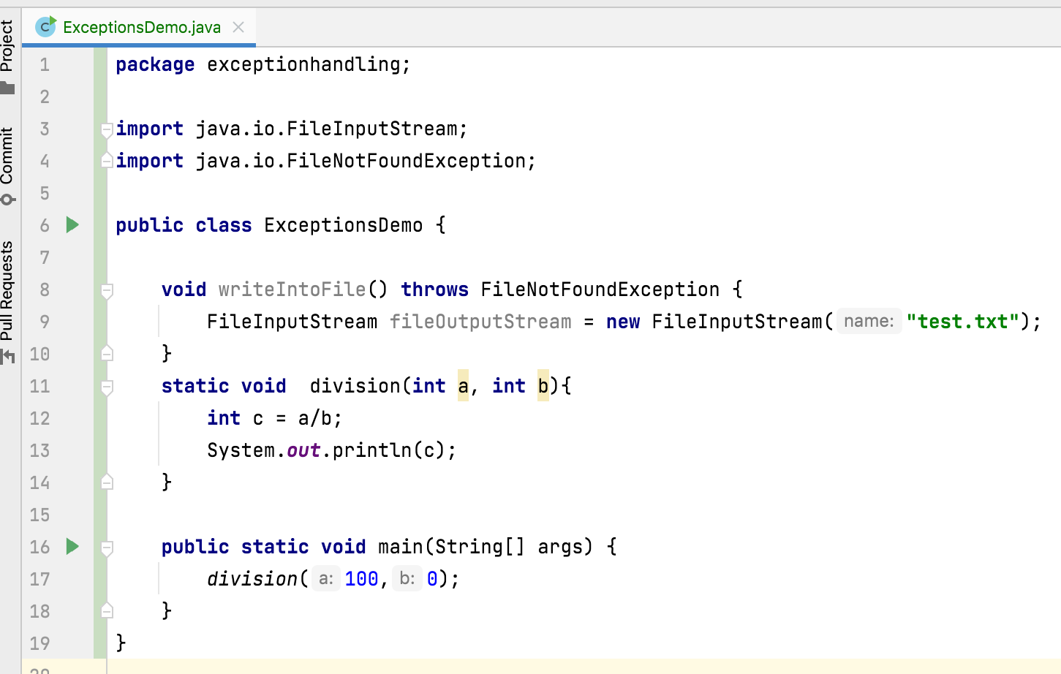
Unchecked Exception:

Slide 5
Checked Exception:
All the sub classes of java.lang.Exception (except sub classes of java.lang.RunTimeException) are checked exceptions.
Examples : FileNotFoundException, IOException, SQLException, ClassNotFoundException, InterruptedException, ParseException
Unchecked Exceptions:
All the sub classes of java.lang.RunTimeException are unchecked exceptions.
Examples : NullPointerException, ArithmeticException, ClassCastException, ArrayIndexOutOfBoundsException, IllegalArgumentException

Slide 6

Thank You !
momedaram

